Slide 1

Gender Voice Classifier
By Satyam kumar - 2021UGECE28
Shaik Mahammad Tarik -2021UGECE30
Faculty Coordinator : DR.Nagaraj sir

Slide 2
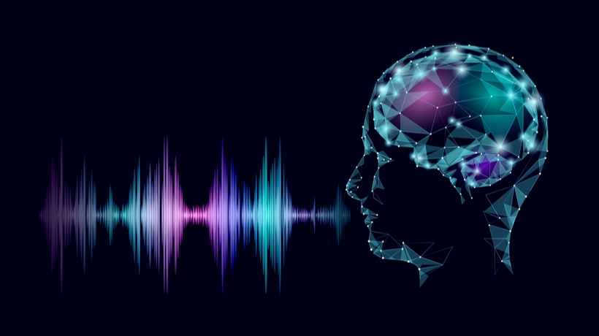
Agenda
Introduction
Tools, Libraries, and Modules Used
Data Acquisition and Preprocessing
Model Development
Results and Evaluation
Conclusion

Slide 3



Introduction:
In today's digital age, the ability to accurately detect gender from voice samples holds immense significance across various domains.
From enhancing speech recognition systems to enabling gender-based marketing strategies, voice gender detection plays a crucial role in numerous applications.
Voice gender detection is particularly important in speech recognition systems, where it helps tailor responses and interactions based on the user's gender.
It also finds applications in customer service automation, allowing companies to provide personalized experiences to their clients.
Moreover, in fields such as gender-based marketing and advertising, voice gender detection aids in targeting specific demographics with tailored campaigns, ultimately enhancing customer engagement and satisfaction.

Slide 4



Tools, Libraries, and Modules Used:
Python: Programming language used for development.
scikit-learn: Machine learning library used for model development and evaluation.
numpy: Library for numerical computations and array operations.
pandas: Library for data manipulation and analysis.
matplotlib: Library for creating visualizations and plots.
seaborn: Statistical data visualization library for creating informative and attractive visualizations.
tkinter: Standard GUI (Graphical User Interface) toolkit for creating desktop applications with Python.
Pillow: Python Imaging Library used for image processing tasks.
ImageTk: Module from the Pillow library used for handling images in Tkinter GUI applications.
warnings: Module for handling warnings generated during code execution.
xgboost: Library for gradient boosting machine learning algorithms.

Slide 5


IMPORTANT STEPS
Data Acquisition and Preprocessing:
Loading the dataset
Exploring the dataset
Data cleaning (handling missing values, outliers, etc.)
Feature selection and engineering
Label encoding for the target variable (male/female)
Model Development:
Selection of machine learning algorithms (e.g., K-Nearest Neighbors, Support Vector Machines, Decision Trees)
Splitting the dataset into training and testing sets
Training the model using the chosen algorithm(s)
3.Evaluation and Validation:
Assessing the performance of the trained model using evaluation metrics (e.g., accuracy, precision, recall, F1-score)
Cross-validation to validate the robustness of the model

Slide 6
4.Visualization and Interpretation:
Visualizing the results (e.g., confusion matrix, ROC curve)
Interpreting the model's predictions and insights gained from the analysis
5.Deployment and Integration:
Integrating the trained model into a production environment or application
Testing the model in real-world scenarios
Continuous monitoring and improvement of the deployed model
6.Conclusion and Future Work:
Summary of key findings and insights
Implications of the model's performance in real-world applications
Suggestions for future improvements and research directions

Slide 7

ML MODELS USED
K-Nearest Neighbors (KNN): KNN classifies data points by the majority class of their k-nearest neighbors, making no assumptions about data distribution.
Naive Bayes: Naive Bayes calculates the probability of a sample belonging to a class based on the joint probability of its features, assuming independence.
Decision Tree: Decision trees recursively split data based on attributes to maximize homogeneity within subsets, providing interpretable classification.
Random Forest: Random Forest aggregates predictions of multiple decision trees to improve accuracy and reduce overfitting.
XgBoost: XgBoost sequentially builds weak learners to correct errors, producing accurate predictions through ensemble learning.
Support Vector Machine (SVM): SVM finds the optimal hyperplane for class separation in high-dimensional spaces by maximizing the margin.
Neural Network: Neural networks, particularly Multi-Layer Perceptrons (MLPs), learn complex patterns through interconnected layers of neurons, emulating human brain function.

Slide 8


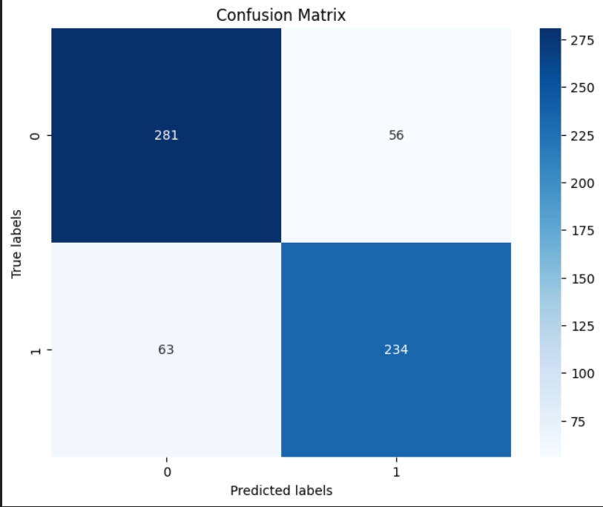


Slide 9

Conclusion:
Based on the analysis, XGBoost and SVM outperformed other algorithms for gender prediction, emphasizing the significance of hyperparameter tuning. Further validation and exploration of feature engineering techniques are warranted to enhance model robustness and generalization.

Slide 10


